Slide 1

The Floyd-Warshall algorithm

Slide 2
Introduction
The problem
Floyd-Warshall

Slide 3
The problem
Given a directed graph G = (V, E)
G is also called a digraph
We would like to create a new digraph G* = (V*, E*) such that
V* = V
E* includes the edge (u, v) whenever there is a path from u to v in G
G* is called the transitive closure of G
Very handy for things like routing in networks

Slide 4
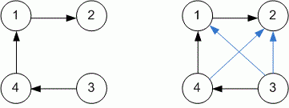
The problem

Slide 5
Floyd-Warshall
This is a dynamic programming algorithm
As such we need
Some place to start
Some way to build up from simpler solutions to more complex ones
We can start by simply placing all the edges in E into E*
This will take care of all paths of length 1
Then we can work from paths through smaller-numbered nodes to larger-numbered nodes
We will assume there are n vertices and m edges

Slide 6
Floyd-Warshall
To start, let us arbitrarily number the vertices in V = {v₁, v₂, …, v_{n}}
Every edge in G (and G*) looks like (v_{i}, v_{j})
Which means that there is an edge from v_{i} to v_{j}
We can now define how to get from G to G* by creating intermediate graphs G₀, G₁, …G_{n}
Graph G₀ will contain just the edges already in G
G₁ will contain G₀, plus new edges (v_{i}, v_{j}) whenever G₀ contains edges (v_{i}, v₁) and (v₁, v_{j})
G₂ will contain G₁, plus new edges (v_{i}, v_{j}) whenever G₁ contains edges (v_{i}, v₂) and (v₂, v_{j})
And so on

Slide 7
Floyd-Warshall
In short, G_{k} adds an edge (v_{i}, v_{j}) whenever G_{k-1} has edges (v_{i}, v_{k}) and (v_{k}, v_{j})
When G_{k} is complete, if there is a path from v_{i} to v_{j} that runs through v_{k}, G_{k} will have an edge (v_{i}, v_{j})
Of course, k will go all the way up to n (the number of vertices), so when the algorithm is complete the above statement turns into:
If v_{i} is directly connected to v_{j}, or if there is a path from v_{i} to v_{j} that runs through
any vertex, G_{n} will have an edge (v_{i}, v_{j})
Which is what we want

Slide 8
Floyd-Warshall
In pseudocode:
G₀ = G
for k in 1..n:
G_{k} = G_{k-1} ⋃ (v_{i}, v_{j}) if G_{k-1} contains both (v_{i}, v_{k}) and (v_{k}, v_{j})
G* = G_{n}

Slide 9
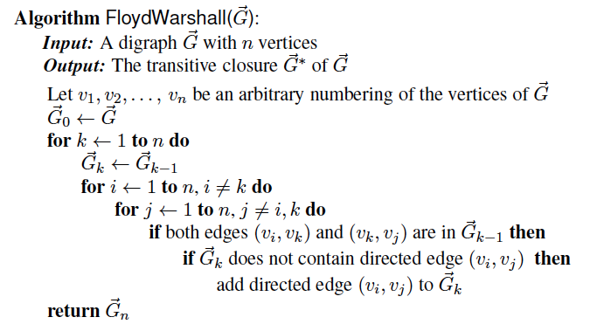
Floyd-Warshall

Slide 10
Floyd-Warshall
It is easy to see this is O(n³)
Why does it work?
Informally:
(v_{i}, v_{j}) belongs in G* if either of two things is true
(v_{i}, v_{j}) is in G
There is a path from v_{i} to v_{j} that passes through some intermediate vertex v_{x}

Slide 11
Floyd-Warshall
The algorithm successively connects vertices until it builds (v_{i}, v_{x}) and (v_{x}, v_{j}), and then builds (v_{i}, v_{j})
The algorithm does not miss any vertex pairs
A worked-out example follows

Slide 12
Floyd-Warshall Example
BOS
ORD
v
4
JFK
v
2
v
6
SFO
DFW
LAX
v
v
3
1
MIA
v
5

Slide 13
Floyd-Warshall, Iteration 1
BOS
ORD
v
4
JFK
v
2
v
6
SFO
DFW
LAX
v
v
3
1
MIA
v
5

Slide 14
Floyd-Warshall, Iteration 2
BOS
ORD
v
4
JFK
v
2
v
6
SFO
DFW
LAX
v
v
3
1
MIA
v
5

Slide 15
Floyd-Warshall, Iteration 3
BOS
ORD
v
4
JFK
v
2
v
6
SFO
DFW
LAX
v
v
3
1
MIA
v
5

Slide 16
Floyd-Warshall, Iteration 4
BOS
ORD
v
4
JFK
v
2
v
6
SFO
DFW
LAX
v
v
3
1
MIA
v
5

Slide 17
Floyd-Warshall, Iteration 5
BOS
ORD
v
4
JFK
v
2
v
6
SFO
DFW
LAX
v
v
3
1
MIA
v
5

Slide 18
Floyd-Warshall, Iteration 6
BOS
ORD
v
4
JFK
v
2
v
6
SFO
DFW
LAX
v
v
3
1
MIA
v
5

Slide 19
Floyd-Warshall, Conclusion
BOS
ORD
v
4
JFK
v
2
v
6
SFO
DFW
LAX
v
v
3
1
MIA
v
5

Slide 20
Floyd-Warshall
As a side note, if the edges are weighted, Floyd-Warshall can be used to find the shortest path for all pairs of vertices
The modification is a small one
Making the modification is left as an exercise for the student

